Slide 1
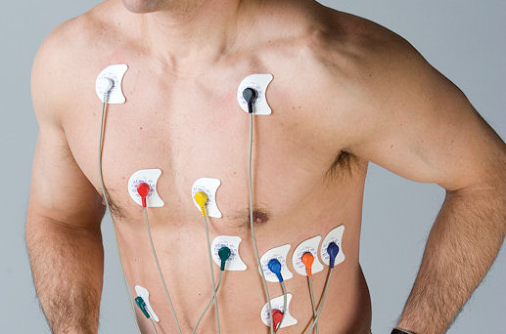
How different biological signals are transduced
Transducers
Function
Types
capacitive
photo-electric
piezo-electric
inductive
pressure
thermocouple
Electrodes
Types
Placement
Electrode-electrolyte interface
Application
13.1.1 Demonstrating how different biological signals are transduced
Unit B 13.1 Measuring Biological Signals
Module 279 18 B Medical Instrumentation I
©
dr. Chris R. Mol, BME, NORTEC, 2015

Slide 2
Physiological Signals:
What is a Measurand?
A measurand is a physiological event that you want to measure ….
What Measurands are there?
Position, motion, velocity acceleration, force, pressure, volume, flow, heat, temperature, humidity, light intensity, sound level, chemical composition, electric current, electric voltage, etc.
©
Biological Signals
dr. Chris R. Mol, BME, NORTEC, 2015

Slide 3
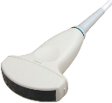
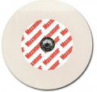
Transducer Function
What is a Transducer?
A transducer is any device used to convert energy from one form to another; typically when converting input energy into output energy.
An example is a microphone, which converts the input energy, the sound waves produced by a voice or instrument, to output energy, the electrical impulses in the form of amplified sound. Also: a loudspeaker which does the opposite.
What is a Sensor ?
A sensor is a transducer that converts the measurand (the thing you want to measure) into a signal that is compatible with a measurement system (often electrical).
What is an Electrode ?
An electrode is a sensor that directly acquires an electrical signal without the need to convert it to another form: both input and output are electrical signals.
Conversion of a physiological event into an electric signal makes it easier to use modern technology to process and display the event in a user-friendly format.
©
Transducers
dr. Chris R. Mol, BME, NORTEC, 2015

Slide 4
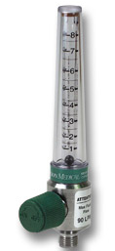
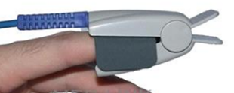
Transducer Types
This presentation:
Capacitive transducers
Photo-electric transducers
Piezo-electric transducers
Inductive transducers
Pressure transducers
Thermo-couple transducers
Transducer characteristics:
Direct transducers measure directly the measurand you are interested in.
Indirect transducers measure a derived value (e.g. Korotkoff sounds)
Intermittent transducers give intermittent values (e.g. oral thermometer);
Continuous transducers give measurement values for a prolonged period of time
Invasive transducers need to be brought inside the body;
Non-invasive transducers work from the outside of the body.
There are many more types of transducers, e.g. electrochemical, thermistors, radiation sensors, …
©
Transducers
dr. Chris R. Mol, BME, NORTEC, 2015

Slide 5
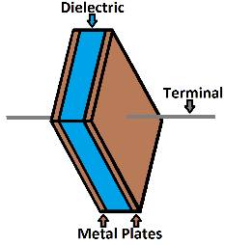
Capacitive Transducers
What is a Capacitance?
A capacitor can be constructed with two parallel plates separated by a non-conductive medium such as air. Capacitance depends on the area (A) of the plates and the distance (d) between the plates. The capacitance also changes with the dielectric constant (ε₀) of the material used in it.
What is a Capacitive Transducer?
The capacitive transducer is a capacitor with variable capacitance. In the typical capacitor the distance between the two plates is fixed, but in variable capacitance transducers the distance between the two plates is variable.
What is it used for ?
It is used for the measurement of e.g. displacement (and related: velocity and acceleration) or pressure in many applications.
©
Transducers
dr. Chris R. Mol, BME, NORTEC, 2015

Slide 6
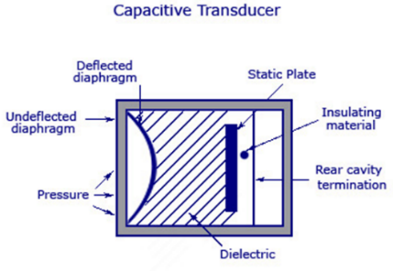
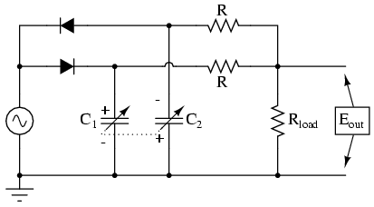
Capacitive Transducers
How does it work ?
In the instruments using capacitive transducers the value of the capacitance changes due to change in the value of the input quantity that is to be measured (e.g. pressure, displacement).
This change in capacitance can be measured in an electronic circuit and can be calibrated against the input quantity. Thus the value of the input quantity can be measured directly.
©
Transducers
dr. Chris R. Mol, BME, NORTEC, 2015

Slide 7
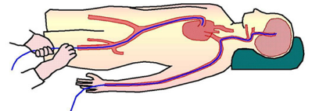
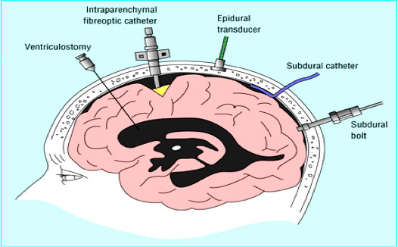
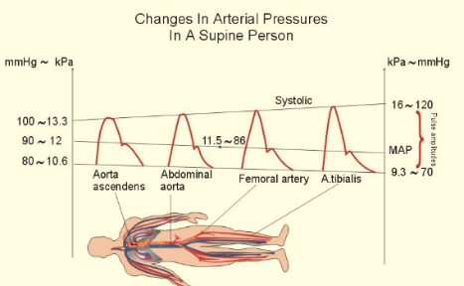
Capacitive Transducers: applications
Medical Applications: e.g. Invasive measurement of blood-pressure; intra-ocular pressure and intra-cranial pressure.
All at the tip of a catheter.
©
Transducers
dr. Chris R. Mol, BME, NORTEC, 2015

Slide 8
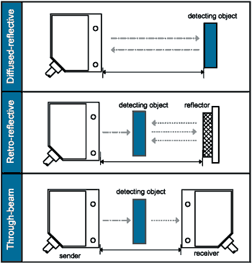
Photo-electric Transducers
What is the
photo-electric effect ?
This is the ejection of electrons of a metal or semi-conductor surface when illuminated by light (EM-radiation) of a suitable wave-length.
What is a
photo-electric sensor ?
This sensor uses the photo-electric effect to convert light energy into electrical energy. When light falls on photosensitive element, electric current is generated that is measured directly or after amplification.
It can be used to detect the distance, absence, or presence of an object.
There are three different functional types:
opposed (through beam),
retro-reflective
proximity-sensing (diffused)
©
Transducers
dr. Chris R. Mol, BME, NORTEC, 2015

Slide 9
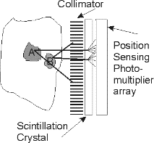
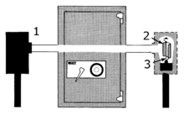
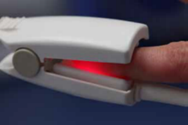
Photo-electric Transducers: applications
These transducers are widely used in various medical applications, such as detectors for computed tomography (coupled with scintillators), instruments to analyse samples (immunoassay), and pulse oximeters.
The Pulse oximeter measures oxygen concentration in blood via light transmission
X-ray detection in CT scanning
The common solar cell used to generate electric solar power is a large area photodiode.
Through beam application
in security
©
Transducers
dr. Chris R. Mol, BME, NORTEC, 2015

Slide 10
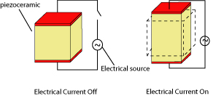
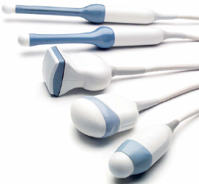
Piezo-electric Transducers
What is the
piezo-electric effect ?
The effect in some materials that electricity is generated when they are deformed or,
the other way around: when an electric current is applied, these materials are deformed.
Piezo- means 'press' or 'squeeze‘ (in Greek language)
What materials
show this effect?
Natural, single-crystal materials (gallium phosphate, quarts)
have limited effect and long term stability.
Piezo-electric ceramics have higher sensitivity and are easier to shape.
What is a piezo-electric
transducer ?
A device that uses the piezoelectric effect, to measure changes in pressure, acceleration, temperature, strain, or force by converting them to an electrical charge.
©
Transducers
dr. Chris R. Mol, BME, NORTEC, 2015

Slide 11
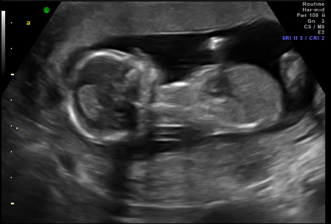
Piezo-electric Transducers: applications
An early application of piezo transducer technology occurred during World War I with the use of sonar, which used echoes to detect the presence of enemy ships
Piezoelectric transducers can be used for numerous applications for industrial, environmental and personal use. Air transducers, for instance, are frequently used in automobile, proximity and level sensors. They are commonly used in residential products like motion and object detectors, pest deterrents and home security alarms. They are also used in electronic devices, such as toys, games and remote control units. They are used in electronic sphygmo-mano-meters for measuring blood pressure and in phono-cardiography.
A piezoelectric ultrasonic transducer generates ultrasonic activity, meaning it produces sound waves above the frequencies that can be heard by the human ear. It functions by rapidly expanding and contracting when appropriate electrical frequency and voltage is applied.
Ultrasound Imaging systems are used in various applications in hospitals to image unborn babies, heart valves, blood vessels, abdomens, etc. These are discussed in course: Medical Instruments II.
©
Transducers
dr. Chris R. Mol, BME, NORTEC, 2015

Slide 12
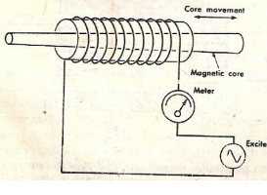
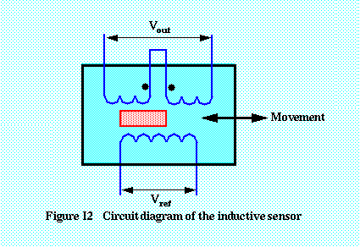
Inductive Transducers
What is (magnetic)
induction?
Electromagnetic induction is the production of an electromotive force across a conductor when it is exposed to a time varying magnetic field.
Induction of the magnetic material depends on a number of variables like the number of turns of the coil on the material, the size of the magnetic material, and the permeability of the flux path.
What is an inductive
transducer?
Inductive transducers measure movement based on the fact that magnetic induction is changed by this motion. (The magnetic materials are used in the flux path and there are one or more air gaps. The change in the air gap results in change in the inductance of the circuit).
©
Transducers
dr. Chris R. Mol, BME, NORTEC, 2015

Slide 13
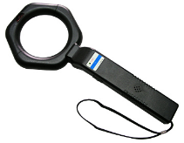
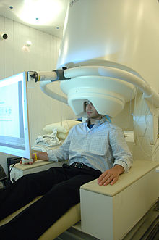
Inductive Transducers: applications
Common applications of inductive sensors include metal detectors, traffic lights, car washes, etc. The sensor does not require physical contact, which makes it particularly useful for some applications.
Magneto EncephaloGraphy is a non-invasive technique for investigating human brain activity. It allows the measurement of ongoing brain activity on a millisecond-by-millisecond basis, and it shows where in the brain activity is produced.
The most sensitive low-field sensor is the superconducting quantum interference device (SQUID). SQUID magnetometers can detect fields from several femto-tesla up to 9 tesla, a range of more than 15 orders of magnitude. This is essential in medical applications since the neuro-magnetic field of the human brain is only a few tenths of a femto-Tesla; Earth's magnetic field, by way of comparison, is ~50 microTesla. SQUIDs require cooling to liquid helium temperature (4 kelvin) at present, but devices are under development that will operate at higher temperatures.
©
Transducers
dr. Chris R. Mol, BME, NORTEC, 2015

Slide 14
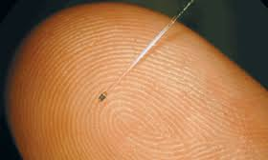
Pressure Transducers
What is a pressure
transducer/sensor
(manometer)?
A pressure sensor measures pressure, typically of gases or liquids. Pressure is an expression of the force required to stop a fluid from expanding, and is stated in terms of force per unit area.
A pressure sensor usually generates an (electric) signal as a function of the pressure imposed.
Pressure sensors can vary drastically in technology, design, performance, application suitability and cost.
Technologies used can be e.g. capacitive, electro-magnetic, piezo-electric, optical, ….
A conservative estimate would be that there may be over 50 technologies and at least 300 companies making pressure sensors worldwide.
miniature fiber optic pressure sensor
©
Transducers
dr. Chris R. Mol, BME, NORTEC, 2015

Slide 15
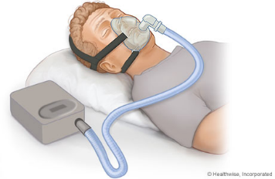
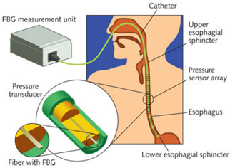
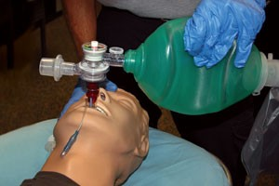
Pressure Transducers: applications
Pressure sensors are used for control and monitoring in thousands of everyday applications. Pressure sensors can also be used to indirectly measure other variables such as fluid/gas flow, speed, water level, and altitude.
Examples of Medical Applications:
Invasive and non-invasive blood pressure monitors,
fetal heart rate monitors
Sleep apnea
Flow meters (in ventilators)
©
Transducers
dr. Chris R. Mol, BME, NORTEC, 2015

Slide 16
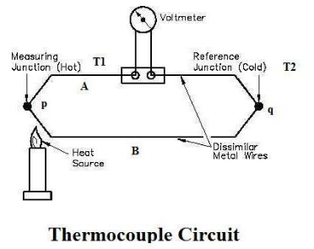
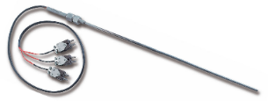
Thermo-Couples
What is the thermo-electric effect?
Any conductor that is subjected to a thermal gradient, will generate a voltage. This voltage depends on the material properties of the conductor.
What is a
thermo-couple?
In a thermocouple, the thermo-electric effect is used to build a temperature-measuring device. It consists of two dissimilar conductors that contact each other at one or more spots, where a temperature differential is experienced by the different conductors (or semi-conductors).
In contrast to most other methods of temperature measurement, thermocouples are self powered and require no external form of excitation.
The main limitation with thermocouples is their limited accuracy; system errors of less than one degree Celsius (°C) are difficult to achieve.
©
Transducers
dr. Chris R. Mol, BME, NORTEC, 2015

Slide 17
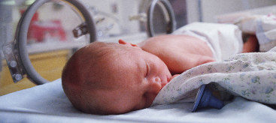
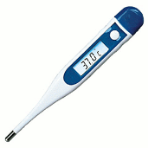
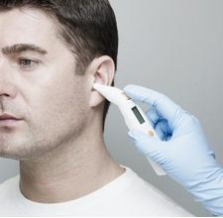
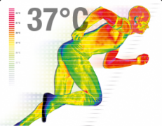
Thermo-Couples: applications
Thermocouples are suitable for measuring over a large temperature range, from −270 up to 3000 °C Applications include temperature measurement for kilns, gas turbine exhaust, diesel engines, other industrial processes and fog machines.
They are less suitable for applications where smaller temperature differences need to be measured with high accuracy, for example the range 0–100 °C with 0.1 °C accuracy. For such applications thermistors, silicon bandgap temperature sensors and resistance thermometers are more suitable.
In medical applications body temperature is often an important parameter,
e.g. hypo-thermia in anaesthesia and in shock, for incubators, in arthritis, ….
©
Transducers
dr. Chris R. Mol, BME, NORTEC, 2015

Slide 18
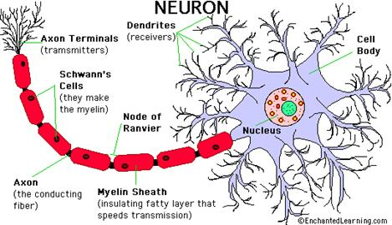
Electrodes
Why is there electricity in the body?
Nerves send electric signals throughout the body to coordinate activities. Nerve (neuron) signals instruct muscles to contract, transport sense signals to the brain and signal a lot of data that we are not aware of. Also muscle activity is associated with electrical (biochemical) activity.
Can we measure this electricity?
Yes, we can measure electric signal directly into nerves or nerve bundles and muscle cells. We can measure integrated activity from many nerves and muscles at the outside of the body, e.g. from the brain (EEG), the heart (ECG) and other muscles (EMG).
What is the use of electrodes?
Electrodes are electrical conductors which are positioned in the electro-magnetic field of the body. They register the electric signals of the body which can then be analysed and interpreted.
©
Transducers
dr. Chris R. Mol, BME, NORTEC, 2015

Slide 19
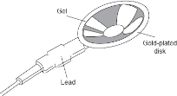
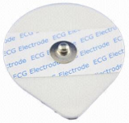
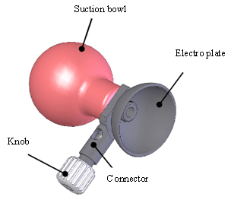
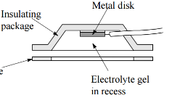
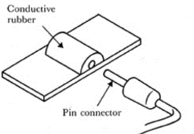
Electrode Types
Metal Plate Electrodes
large surface electrodes for ECG
metal disk electrodes for EMG, EEG
stainless steel with coating of platinum or gold
Disposable foam pad (cheap!) for ECG
application to limb
application with surgical tape
Suction Electrodes
no adhesives. For ECG (short term only)
Floating Electrodes
recessed metal disk (swimming in gel)
less sensitive to motion
Flexible Electrodes (may fit better)
polymer or nylon with silver deposits
or carbon filled silicon rubber as thin film
©
Transducers
dr. Chris R. Mol, BME, NORTEC, 2015

Slide 20
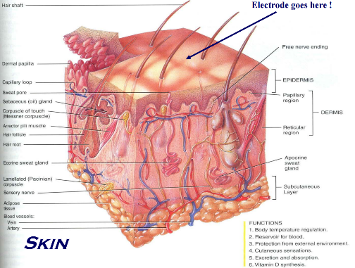
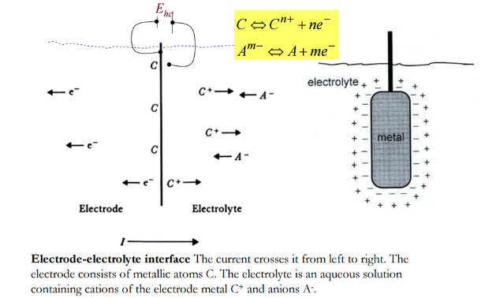
Electrode-electrolyte interface
The interface required for the charge transfer is the electrode – electrolyte interface.
The electrolyte is a conducting medium, specifically formulated for the electrode metal being used.
©
Transducers
dr. Chris R. Mol, BME, NORTEC, 2015

Slide 21
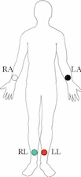
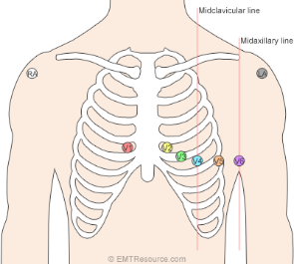
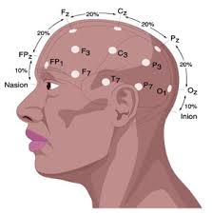
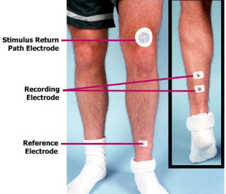
Electrode Placement and Applications
ECG
Vector Cardiogram
EEG
EMG
Electrode placement in various clinical applications is further discussed elsewhere
©
Transducers
dr. Chris R. Mol, BME, NORTEC, 2015

Slide 22
END
The creation of this presentation was supported by a grant from THET:
see https://www.thet.org/

